Slide 1
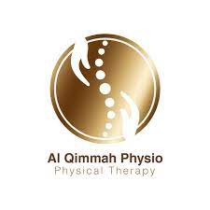
AL Qimmah Physio Center Course: BMD302 Instructor: Dr. Sahar Ali Fawzy Semester: Fall 22
Presented by:
Islam Ahmed 202000325
Hazem Nasr 202000937
Farida Ismail 202000184
Loujine Waleed 202000781
Evoon Mina 202001821

Slide 2
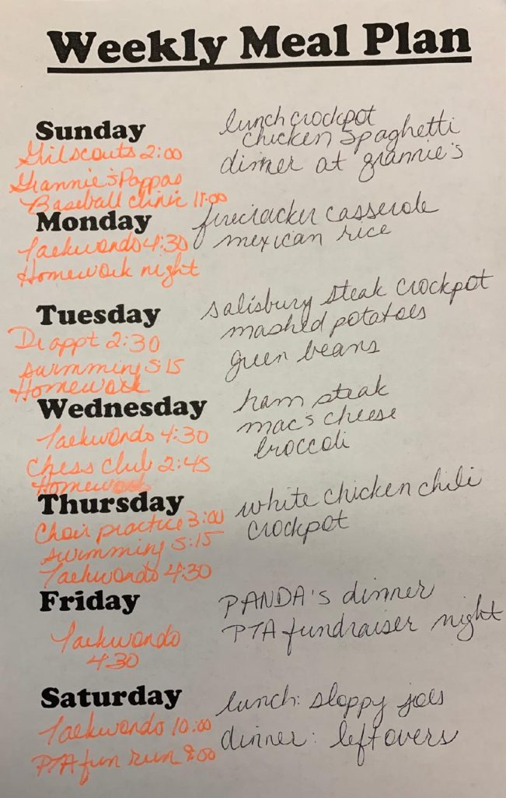
Problem Definition
Many people struggle with being overweight and don't know how to lose weight, and many others struggle with being extremely thin and struggling to gain weight. People who are overweight or obese are more likely to develop major illnesses and medical disorders including high blood pressure, stroke, diabetes, and other conditions than those who are at a healthy weight.
We looked at the various problems that may occur in health care owing to insufficient documentation, including sloppy handwriting, missing paperwork, and the use of the incorrect abbreviations, which can all result in incorrect diagnosis and treatment—and in some circumstances, even death.

Slide 3
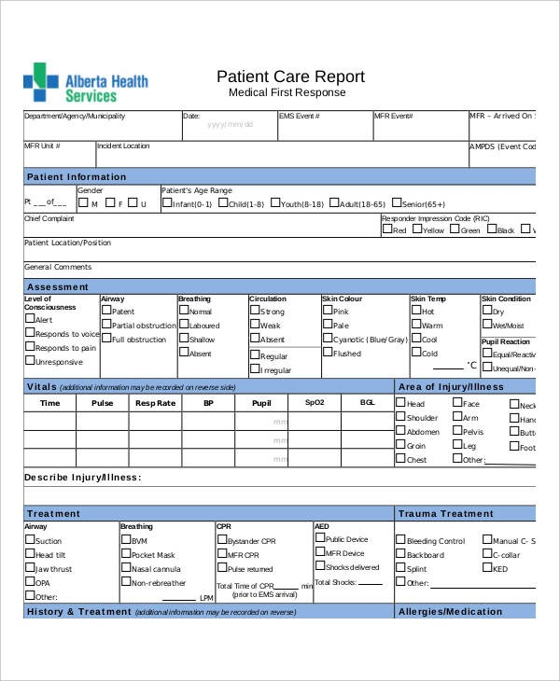
Proposed Solution
Using Visual Studio, we will create a desktop application for a clinical nutrition system that will make it simple for doctors and nurse to connect with one another and reduce the human errors that occurs in traditional nutrition clinics.
To minimize typical mistakes from handwriting that may be difficult for certain individuals to read and to prevent missing data, the system will be totally computerized. When the nurse views the patient profile, all of this information will be visible, and everything will be recorded correctly in case you need to refer to the reports. Doctors and receptionists will spend less time on paperwork due to this.
The Doctor will also look at the patient medical record before he arrives to know sufficient information about the patient, their allergies and their symptoms. The doctor will treat the patient and diagnose him and will add it in the system. With this electronic system, the doctor can navigate through his patients with the integrated view and can save his weight reports electronically. The doctor will also have the ability to use the OCR module that helps him to convert inbody reports to text.

Slide 4
Features of our system
Electronic
To avoid handwriting error
Integrated
Consists of databse, patient medical record, and nurse view
User-Friendly
Both Doctor and nurse are able to carry out their duties easily

Slide 5
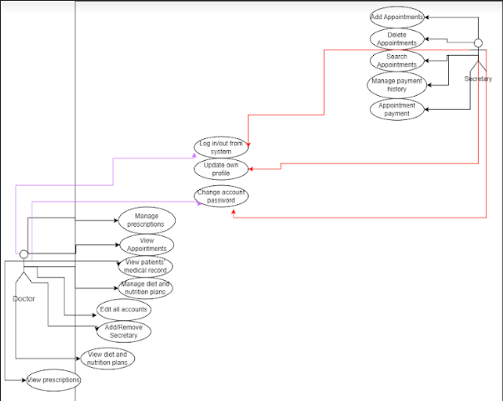
User Case Diagram

Slide 6
Wireframes

Slide 7
ERD

Slide 8
Sequence Diagram

Slide 9
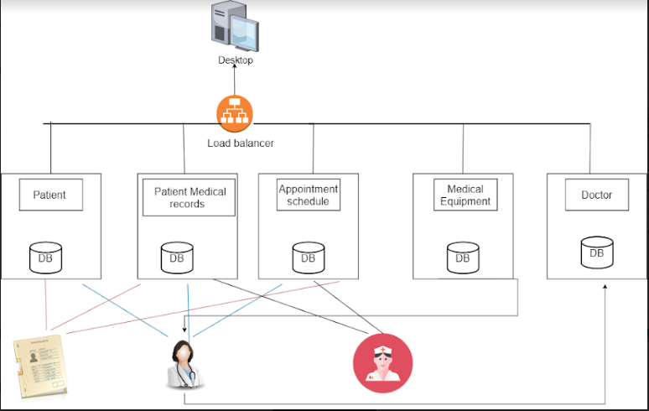
High-Level Architecture

Slide 10
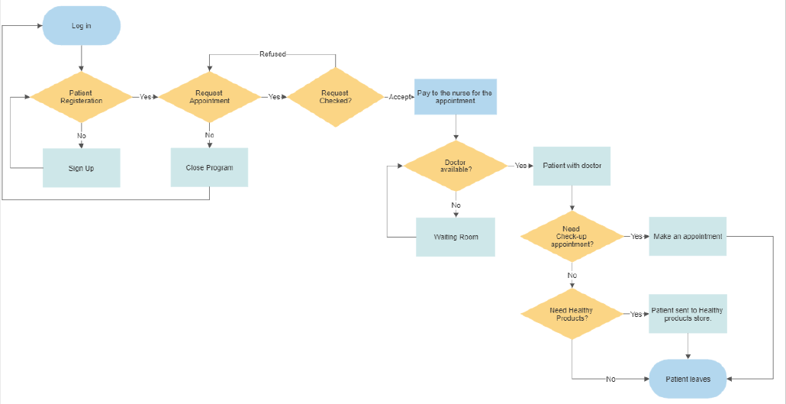
Workflow Diagram

Slide 11
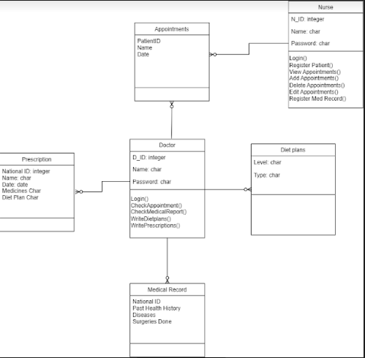
Class Diagram

Slide 12
Interfaces
Log -In
01
The first interface that appears to doctor and nurse to log in
Doctor View
02
Access to appointments, write diet plans and prescription, view medical record
Nurse View
Add new patients, have access to medical record, and book appointments
03
Medical Record
04
Viewed by doctor and nurse

Slide 13
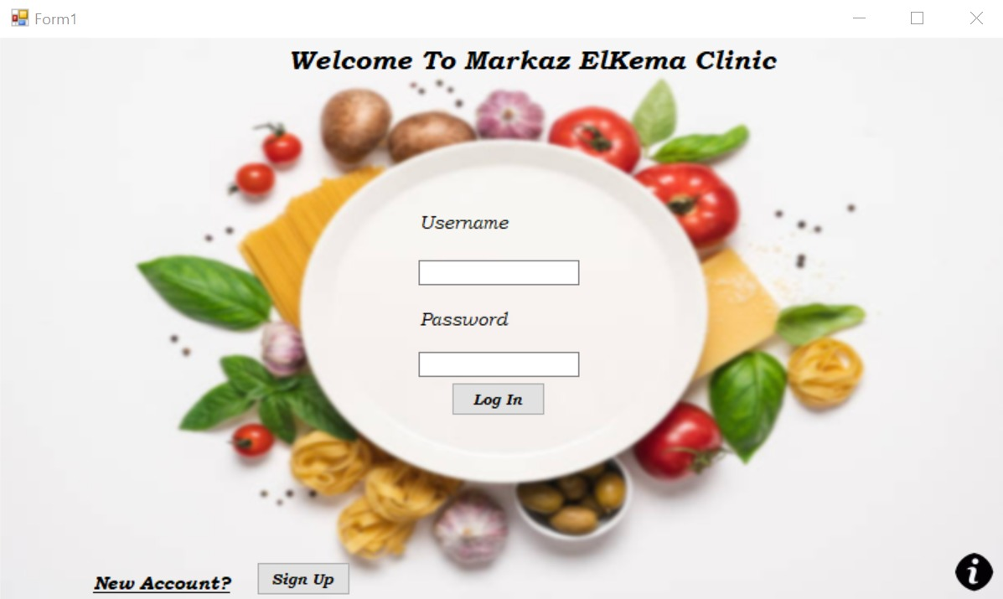
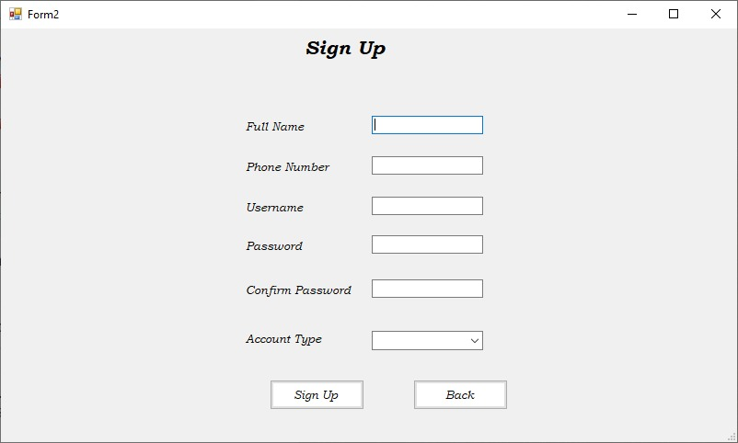
Log in and Sign up Page

Slide 14
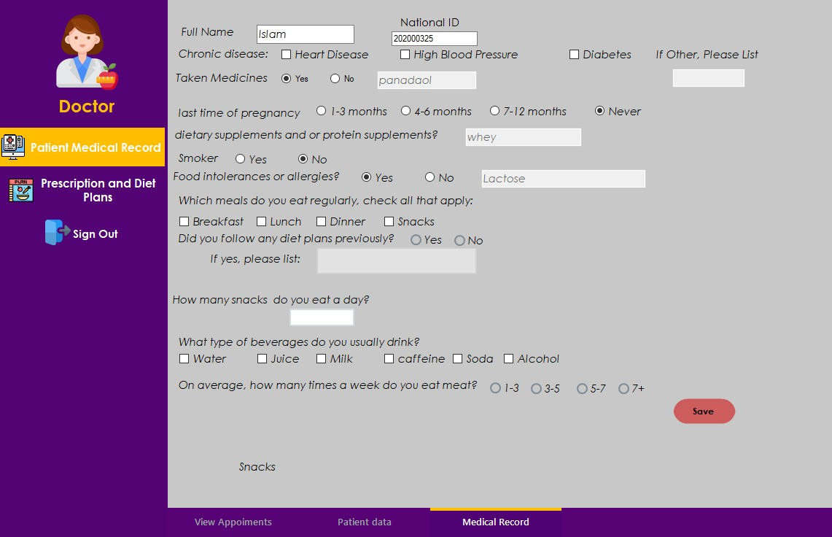
Doctor Dashboard Patient Medical Record

Slide 15
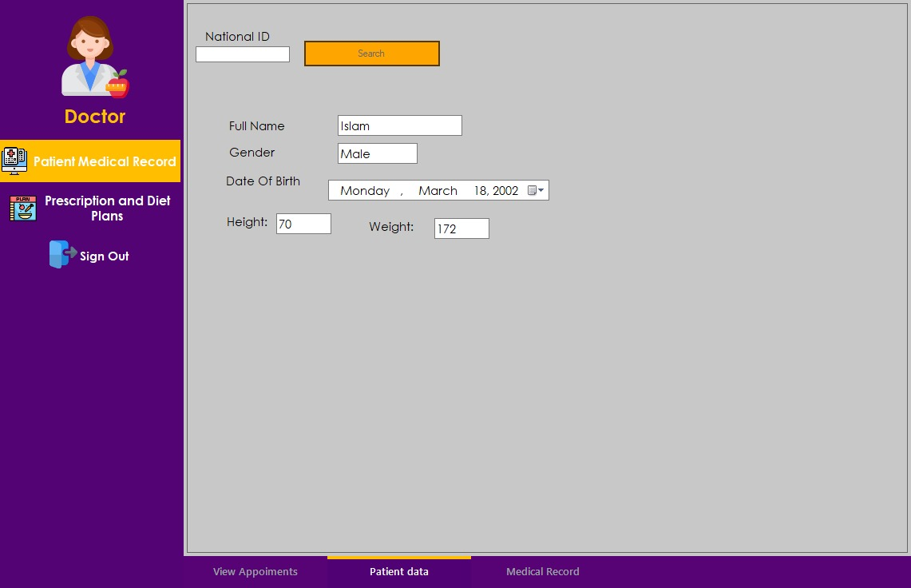
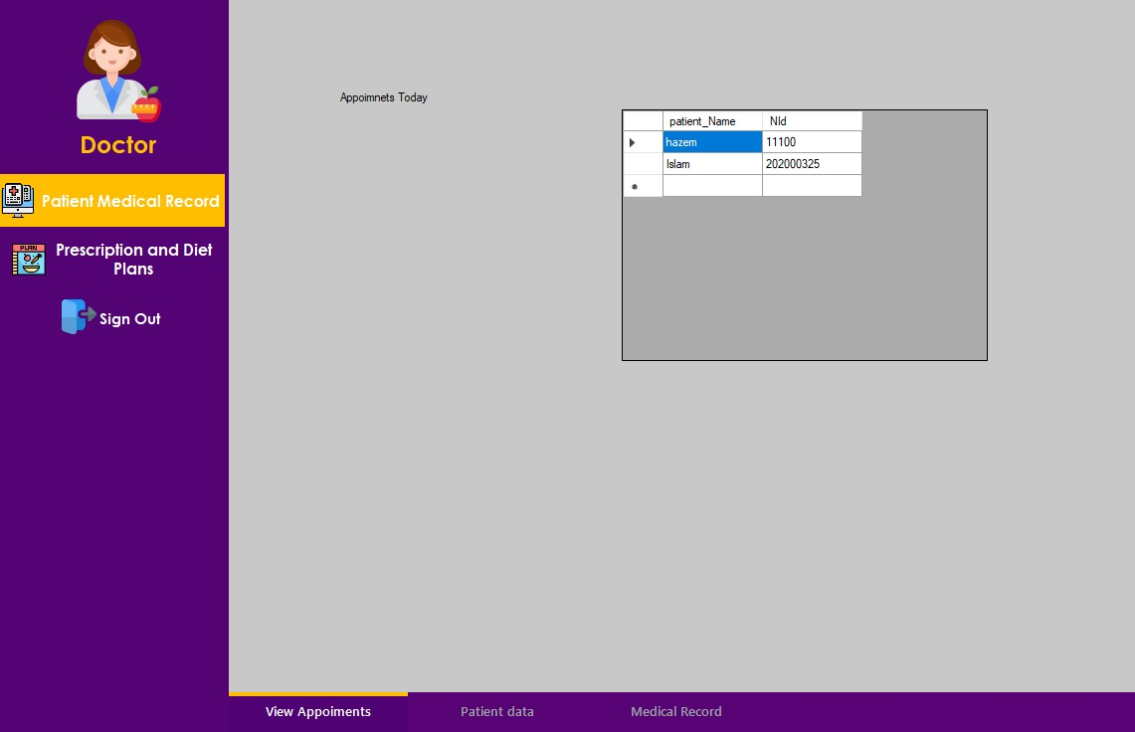
Doctor Dashboard Patient Data

Slide 16
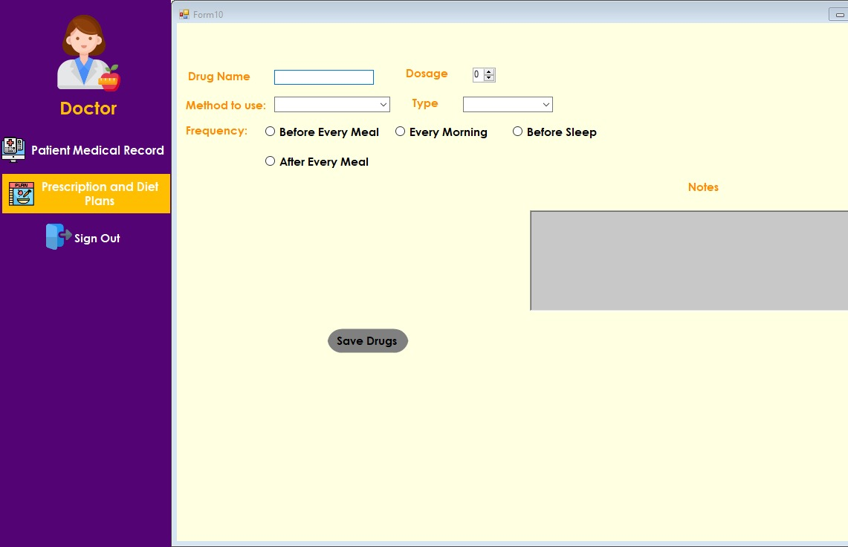
Doctor Dashboard Prescription and Diet Plan

Slide 17
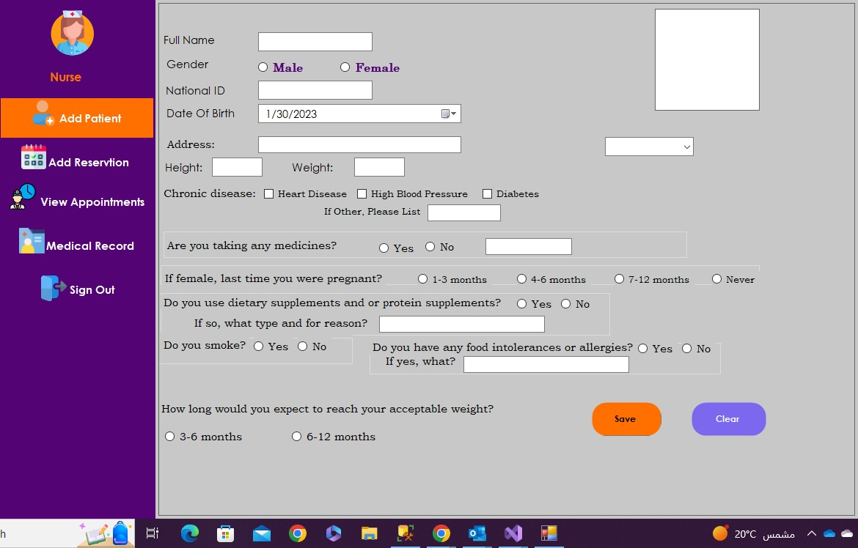
Nurse Dashboard Add Patient

Slide 18
Future Work
This project can be used in any nutrition clinic; we could improve our project by adding, printing out diet plans and prescription for patients and develop a decision support system using machine learning

Slide 19
Thank You

